Slide 1
Estate Planning Council of Delaware, Inc.
State Income Taxation of Trusts
Richard W. Nenno, Esquire
Young Conaway Stargatt & Taylor, LLP
March 2, 2022
6:30 – 7:30 PM

Slide 2

Scope
Introduction
How Do States Tax Trust Income?
Is Imposition of Tax Valid?
How Do Specific States Tax Trust Income?
What are Planning Considerations for New Trusts?
What are Planning Considerations for Existing Trusts?
What are Other Relevant Issues?

Slide 3
Introduction
Background
Opportunity
  Introduction
  Stakes Are High
    NY: In 2014, 59,685 resident fiduciaries paid $342 million of income tax
    NJ: In 2016, 84,909 resident fiduciaries paid $173 million of income tax
  Opportunities Are Great—by structuring trust to escape state income tax, the following could have been saved on $1 million long-term capital gain:
    CA: $106,869
    NYC: $107,124

Slide 4
Introduction (Continued)
  Federal vs. State Tax Savings—In 2021, including $1 million long-term capital gain in DNI to CA beneficiary rather than taxing gain to trust would have cost—not saved—$71,894
  People Are Doing It—From 1987‒2003, Sitkoff & Schanzenbach found that $100 billion of federally reported trust assets (about 10% of total) moved to states that:
    Had lengthened or abolished RAP for trusts
    Did not tax income of trust created by nonresident
  Risks of Inaction Are Real
  Implications of 2017 Tax Act—Grantor trusts might no longer make sense

Slide 5
How Do States Tax Trust Income?
Nine States Don’t Tax Income of Nongrantor Trusts – AK, FL, NV, NH, SD, TN, TX, WA, WY
Lowest Rate
  ND 2.9%
  PA 3.07%
Highest Rate
  OR 9.9%
  NJ 10.75%
  CA 13.3%
  NYC 14.776%

Slide 6
How Do States Tax Trust Income? (Continued)
Bases of Taxation
Trust Created by Will of Domiciliary/Resident
Inter Vivos Trust Created by Domiciliary/Resident
Trust Administered in State
Trust Having Domiciliary/Resident Trustee/Fiduciary
Trust Having Domiciliary/Resident Beneficiary

Slide 7

Is Imposition of Tax Valid?
Pertinent US Supreme Court Cases
  Brooke v. City of Norfolk (1928)
  Safe Deposit and Trust Co. v. Virginia (1929)
  Guaranty Trust Co. v. Virginia (1938)
  Greenough v. Tax Assessors of Newport (1947)
  Hanson v. Denckla (1958)
  Quill Corporation v. North Dakota (1992)
  South Dakota v. Wayfair, Inc. (2018)
  North Carolina Department of Revenue v. The Kimberley Rice Kaestner
  1992 Family Trust (2019)

Slide 8
Is Imposition of Tax Valid? (Continued)
Recent State Court Cases
  Residuary Trust A U/W/O Kassner v. Director (NJ 2015)
  Linn v. Dep’t of Revenue (IL 2013)
  Fielding for MacDonald v. Commissioner of Revenue (MN 2018)
  McNeil v. Commonwealth (PA 2013)
Constitutional Analysis

Slide 9

Is Imposition of Tax Valid? (Continued)
Taxation of Trust Administered in State
  US Supreme Court Case
  North Carolina Department of Revenue v.
  The Kimberley Rice Kaestner 1992
  Family Trust (US 2019)
  Wisconsin Cases
  Wisconsin Dep’t of Taxation v. Pabst
  (WI 1961)
  Pabst v. Wisconsin Dep’t of Taxation
  (WI 1963)

Slide 10
Is Imposition of Tax Valid? (Continued)
Taxation of Domiciliary/Resident Trustee/Fiduciary
  US Supreme Court Case
  North Carolina Department of Revenue v. The Kimberley Rice Kaestner
  1992 Family Trust (US 2019)
  California Case
  McCulloch v. Franchise Tax Board (CA 1964)
Taxation of Trustee of Trust Having Domiciliary/Resident Beneficiary
  US Supreme Court Cases
  Brooke v. City of Norfolk (1928)
  Safe Deposit and Trust Co. v. Virginia (1929)
  North Carolina Department of Revenue v. The Kimberley Rice Kaestner
  1992 Family Trust (US 2019)

Slide 11
Is Imposition of Tax Valid? (Continued)
Taxation of Trustee of Trust Having Domiciliary/Resident Beneficiary (cont’d)
  California Cases
  McCulloch v. Franchise Tax Board (CA 1964)
  In the Matter of the Appeal of the First National Bank of Chicago (CA 1964)
  In the Matter of the Appeal of C. Pardee Erdman (CA 1970)
North Carolina Department of Revenue v. The Kimberley Rice Kaestner 1992 Family Trust (US 2019)

Slide 12
Is Imposition of Tax Valid? (Continued)
US Due Process Clause
  Taxing State Must Prove
    Trustee has some definite link, some minimum connection, with taxing state; and
    Income attributed to state must be rationally related to values connected with taxing state
  Physical presence in taxing state not required
  Unsettled whether nonstatutory connections must be considered
US Dormant Commerce Clause
  Taxing State Must Prove
    Trustee has substantial nexus with taxing state — physical presence not required; and
    Tax must be fairly apportioned — must be internally and externally consistent; and
    Tax must be fairly related to services provided by taxing state; and
    Tax must not discriminate against interstate commerce
Taxing State Will Have Difficult Burden in Many Cases

Slide 13
Is Imposition of Tax Valid? (Continued)
Zilka v. Tax Review Board City of Philadelphia, 2022 WL 67789 (Pa. Commw. Ct. Jan. 7, 2022)
  Taxpayer lived in Philadelphia and worked in Wilmington 2013-2016
  Taxpayer had to be concerned about:
    Philadelphia wage tax 3.92%
    Wilmington wage tax 1.25%
    PA income tax 3.07%
    DE income tax 5.00%
  Taxpayer reduced her PA income tax by her DE income tax leaving a 1.93% DE income tax excess
  Taxpayer reduced her Philadelphia wage tax by her Wilmington wage tax leaving a 2.67% Philadelphia wage tax balance
  Taxpayer sought to reduce the Philadelphia wage tax balance by the DE income tax excess
  PA Commonwealth Court held that denial of that reduction was not double taxation
  in violation of dormant Commerce Clause
  “[T]he Pennsylvania Commonwealth Court’s analysis in Zilka is fundamentally flawed
  because it fails to examine the constitutional issues,” Hellerstein, 103 Tax Notes
  State 743, 755 (Feb 14, 2022)

Slide 14
Is Imposition of Tax Valid? (Continued)
DE Incomplete Gift Nongrantor Trust (DING Trust)
  Trustor establishes DE APT
    Goals
      Transfers will be incomplete gifts
      Trust will be nongrantor trust
    Trustor might later be able to get tax-free distributions
    NY treats DING Trust as grantor trust
    CA proposal to treat DING Trust as grantor trust in 2022
    Recent article questions tax consequences ̶̶ McCouch, 39 Va. Tax Rev. 419 (Spring 2020)
    IRS has suspended issuing rulings
      Rev Proc. 2021-3 §§ 5.01 (9), (15), (17)
      Rev Proc. 2022-3 §§ 5.01 (9), (15), (18), (19)

Slide 15
How Do Specific States Tax Trust Income?
Delaware (Delaware Personal Income Tax)
  Filing Requirement
  Grantor-Trust Rules
  Distribution Deduction
  Tax Rates: Up to 6.60% over $60,000
  Resident Trust
    Trust created by DE testator (domiciliary)
    Trust created by DE trustor (domiciliary)
    Trust having DE trustee (resident)
  Resident Individual
    Domiciliary
    Place of abode plus more than 183 days in DE

Slide 16
How Do Specific States Tax Trust Income? (Continued)
Delaware (continued)
  Nonresident Trust: Trust not Resident Trust
  Taxation of Trust
    Resident Trust
      Taxed on all DE taxable income
      Nonresident beneficiary deduction: Future beneficiary usually
      treated as nonresident
  Nonresident Trust: Taxed on DE source income
  Estimated Payments: Required
  CRT: Not taxed at trust level

Slide 17

How Do Specific States Tax Trust Income? (Continued)
Delaware (continued)
  DING Trust Option
    Incomplete gift, nongrantor trust
    Available
  Planning
    Domiciliary testator/trustor
    Nondomiciliary testator/trustor

Slide 18
How Do Specific States Tax Trust Income? (Continued)
Delaware (continued)
  Trustee Duty to Minimize Tax
  Examples: $1 million long-term capital gain (2021)
    Structuring trust to eliminate tax saves $64,977
    Including in DNI for DE beneficiary costs $30,274

Slide 19
How Do Specific States Tax Trust Income? (Continued)
New York State (New York State Personal Income Tax)
  Filing Requirement
  Grantor-Trust Rules
  Distribution Deduction
  Tax Rates:
  Resident Trust
    Trust created by NYS testator (domiciliary)
    Trust created by NYS trustor (domiciliary)
$215,400 - $1,077,550 | 6.85%
$1,077,550 - $5,000,000 | 9.65%
$5,000,000 - $25,000,000 | 10.30%
Over $25,000,000 | 10.90%

Slide 20
How Do Specific States Tax Trust Income? (Continued)
New York State (continued)
  Nonresident Trust: Trust not Resident Trust
  Exempt Resident Trust
    No NYS trustee
    No NYS asset
    No NYS source income
    Trustee must file informational return

Slide 21

How Do Specific States Tax Trust Income? (Continued)
New York State (continued)
  Taxation of Trust
    Resident Trust: Taxed on all NYS taxable income
    Nonresident Trust: Taxed on NYS source income
    Estimated Payments: Required
    CRT: Not taxed at trust level
  DING Trust Option
    Incomplete gift, nongrantor trust
    Not available

Slide 22
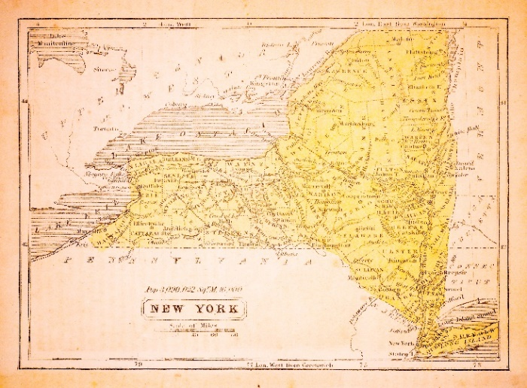
How Do Specific States Tax Trust Income? (Continued)
New York State (continued)
  Planning
    Domiciliary testator/trustor
    Nondomiciliary testator/trustor
  Trustee Duty to Minimize Tax
  Examples: $1 million long-term capital gain (2021)
    Structuring trust to eliminate tax saves $68,493
    Including in DNI for NYS beneficiary costs $33,567

Slide 23
How Do Specific States Tax Trust Income? (Continued)
New York City (New York City Personal Income Tax)
  Filing Requirement
  Grantor-Trust Rules
  Distribution Deduction
  Tax Rates:
  Resident Trust
    Trust created by NYC testator (domiciliary)
    Trust created by NYC trustor (domiciliary)
$215,400 - $1,077,550 | 10.726%
$1,077,550 - $5,000,000 | 13.526%
$5,000,000 - $25,000,000 | 14.176%
Over $25,000,000 | 14.776%

Slide 24
How Do Specific States Tax Trust Income? (Continued)
New York City (continued)
  Nonresident Trust: Trust not Resident Trust
  Exempt Resident Trust
    No NYC trustee
    No NYC asset
    No NYC source income
    Trustee must file informational return

Slide 25

How Do Specific States Tax Trust Income? (Continued)
New York City (continued)
  Taxation of Trust
    Resident Trust: Taxed on all NYC taxable income
    Nonresident Trust: Not taxed
    Estimated Payments: Required
    CRT: Not taxed at trust level
  DING Trust Option
    Incomplete gift, nongrantor trust
    Not available

Slide 26
How Do Specific States Tax Trust Income? (Continued)
New York City (continued)
  Planning
    Domiciliary testator/trustor
    Nondomiciliary testator/trustor
  Trustee Duty to Minimize Tax
  Examples: $1 million long-term capital gain (2021)
    Structuring trust to eliminate tax saves $107,124
    Including in DNI for NYC beneficiary costs $71,892

Slide 27

How Do Specific States Tax Trust Income? (Continued)
New Jersey (New Jersey Gross Income Tax)
  Filing Requirement
  Grantor-Trust Rules
  Distribution Deduction
  Tax Rates: Up to 10.75% over $1 million
  Resident Trust
    Trust created by NJ testator (domiciliary)
    Trust created by NJ trustor (domiciliary)

Slide 28
How Do Specific States Tax Trust Income? (Continued)
New Jersey (continued)
  Nonresident Trust: Trust not Resident Trust
  Exempt Resident Trust
    No NJ asset
    No NJ source income
    No NJ trustee
    Trustee must file informational return

Slide 29
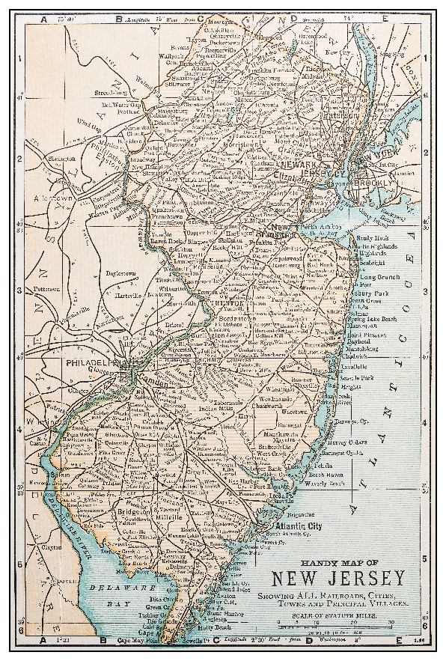
How Do Specific States Tax Trust Income? (Continued)
New Jersey (continued)
  Taxation of Trust
    Resident Trust: Taxed on all NJ gross income
    Nonresident Trust: Taxed on NJ source income
    Estimated Payments: Required
    CRT: Taxed at trust level
  DING Trust Option
    Incomplete gift, nongrantor trust
    Available

Slide 30

How Do Specific States Tax Trust Income? (Continued)
New Jersey (continued)
  Planning
    Domiciliary testator/trustor
    Nondomiciliary testator/trustor
  Trustee Duty to Minimize Tax
  Examples: $1 million long-term capital gain (2021)
    Structuring trust to eliminate tax saves $74,484
    Including in DNI for NJ beneficiary costs $40,099

Slide 31

How Do Specific States Tax Trust Income? (Continued)
Pennsylvania (Pennsylvania Personal Income Tax)
  Filing Requirement
  Grantor-Trust Rules: Not available for irrevocable trust
  Distribution Deduction
  Tax Rate: 3.07%
  Resident Trust
    Trust created by PA testator (resident)
    Trust created by PA trustor (resident)
  Residence of trustee and beneficiaries is immaterial
  in trust residency determination
  Resident Individual
    Domiciliary
    Permanent place of abode plus more than 183 days in PA

Slide 32
How Do Specific States Tax Trust Income? (Continued)
Pennsylvania (continued)
  Nonresident Trust: Trust not Resident Trust
  Exempt Resident Trust: McNeil v. Commonwealth (PA 2013) (US dormant Commerce Clause)
    No PA trustee
    No PA asset
    No PA source income
    Even if discretionary beneficiaries are PA residents
    McNeil followed by In re John S. Coates 2009 Trust (Pa. Bd. Fin. & Rev. 2017)
    McNeil reliance on physical presence disavowed following Wayfair in Andrews v. Commonwealth (Pa. Commw. Ct. 2018)

Slide 33
How Do Specific States Tax Trust Income? (Continued)
Pennsylvania (continued)
  Taxation of Trust
    Resident Trust: Taxed on all PA taxable income
    Nonresident Trust: Taxed on PA source income
    Estimated Payments: Required
    Withholding: Required on source income distributable to nonresident beneficiaries
    CRT: Taxed at trust level
  DING Trust Option
    Incomplete gift, nongrantor trust
    N/A because PA does not have grantor-trust rules for irrevocable trust

Slide 34

How Do Specific States Tax Trust Income? (Continued)
Pennsylvania (continued)
  Planning
    Resident testator/trustor
    Nonresident testator/trustor
  Trustee Duty to Minimize Tax
  Examples: $1 million long-term capital gain (2021)
    Structuring trust to eliminate tax saves $30,700
    Including in DNI for PA beneficiary saves $3,685

Slide 35
How Do Specific States Tax Trust Income? (Continued)
Pennsylvania (continued)
  Determining whether “Resident Trust” is taxable as “Nonresident Trust” following McNeil
    Trustee should not file amended return
    Trustee should file REV-65 Petition with Board of Appeals
    Board of Appeals probably will deny Petition
    Board of Finance and Revenue probably will reverse and grant refund on appeal if denial was based on residence of trustee or beneficiaries
      Hansjoerg Wyss 2004 Descendant’s Trust, BF&R Docket No. 1908934 (June 22, 2017), www.bfrcases.patreasury.gov
      Fox Caleb Deed for Descendants Tr, BF&R Docket No. 1713438 (Dec 3, 2018), www.bfrcases.patreasury.gov
      Felger Elizabeth Y Trust U/W, BF&R Docket No. 2010371 (July 8, 2021),
      www. bfrcases.patreasury.gov

Slide 36
How Do Specific States Tax Trust Income? (Continued)
Pennsylvania (continued)
    Board of Finance and Revenue might not reverse and grant refund on appeal if denial was based on current residence of grantor
      Granger Gift Trust FBO Hailey Granger, BF&R Docket Nos. 2013598, 2013599, 2013602 (Sept. 16, 2021), www.bfrcases.patreasury.gov
    Further appeal should be considered because residence of grantor should be immaterial in determining trust’s residency status
    Make sure to meet appeal deadline

Slide 37

How Do Specific States Tax Trust Income? (Continued)
Maryland (Maryland Income Tax; Maryland County Income Tax)
  Filing Requirement
  Grantor-Trust Rules
  Distribution Deduction
  Tax Rates:
    State: Up to 5.75% over $250,000
    County: Between 2.25%‒3.20%
    State/County: Up to 8.95% over $250,000

Slide 38
How Do Specific States Tax Trust Income? (Continued)
Maryland (continued)
  Resident Trust
    Trust created by MD testator (domiciliary)
    Trust created by MD trustor (current domiciliary)
    Trust principally administered in MD
  Nonresident Trust: Trust Not Resident Trust
  Taxation of Trust
    Resident Trust
      Taxed on all MD taxable income
      Nonresident beneficiary deduction: Applicability to future beneficiaries unclear

Slide 39
How Do Specific States Tax Trust Income? (Continued)
Maryland (continued)
  Taxation of Trust (continued)
    Nonresident Trust: Taxed on MD source income
    Estimated Payments: Required
    CRT: No specific guidance
  DING Trust Option
    Incomplete gift, nongrantor trust
    Available

Slide 40
How Do Specific States Tax Trust Income? (Continued)
Maryland (continued)
  Planning
  Trustee Duty to Minimize Tax
  Examples: $1 million long-term capital gain (2021)
    Structuring trust to eliminate tax saves $87,868
    Including in DNI for MD beneficiary costs $53,290 (Baltimore)

Slide 41

How Do Specific States Tax Trust Income? (Continued)
California (California Personal Income Tax)
  Filing Requirement
  Grantor-Trust Rules
  Distribution Deduction
  Tax Rates: Up to 13.30% over $1 million
  Resident Trust
    Trust with resident fiduciary
    Trust with resident noncontingent beneficiary

Slide 42
How Do Specific States Tax Trust Income? (Continued)
California (continued)
  Resident Individual
    Domiciliary
    In CA for other than temporary or transitory purpose
  Corporate Fiduciary: Transacts major portion of administration in CA
  Nonresident Trust: Trust not Resident Trust

Slide 43

How Do Specific States Tax Trust Income? (Continued)
California (continued)
  Taxation of Trust
    Resident Trust: Taxed on all CA taxable income (apportioned
    based on number of resident fiduciaries and noncontingent beneficiaries)
    Nonresident Trust: Taxed on CA source income
    Estimated Payments: Required
    Throwback Tax
    CRT: Not taxed at trust level
  DING Trust Option
    Incomplete gift, nongrantor trust
    Available; FTB proposal would treat DING Trust as
    grantor trust starting in 2022

Slide 44
How Do Specific States Tax Trust Income? (Continued)
California (continued)
  Planning
  Trustee Duty to Minimize Tax
  Examples: $1 million long-term capital gain (2021)
    Structuring trust to eliminate tax saves $106,869
    Including in DNI for CA beneficiary costs $71,894

Slide 45
What Are Planning Considerations for New Trusts?
How to Approach Issue
  Determine which state statutes apply
  Determine whether imposition of tax violates US Constitution
    Due Process Clause
    Dormant Commerce Clause
Testamentary Trust Created by Domiciliary/Resident
Inter Vivos Trust Created by Domiciliary/Resident
Trust Administered in State
Trust Having Domiciliary/Resident Trustee/Fiduciary
Trust Having Domiciliary/Resident Beneficiary

Slide 46
What Are Planning Considerations for Existing Trusts?
Introduction
Testamentary Trust Created by Domiciliary/Resident
Inter Vivos Trust Created by Domiciliary/Resident
Trust Administered in State
Trust Having Domiciliary/Resident Trustee/Fiduciary
Trust Having Domiciliary/Resident Beneficiary
Effecting Move
  Changing place of administration
  Changing domiciliary/resident trustee/fiduciary to
  nondomiciliary/nonresident trustee/fiduciary
Trustee Duty to Minimize Tax

Slide 47
What Are Planning Considerations for Existing Trusts?
(Continued)
Federal Transfer-Tax Consequences
Personal Jurisdiction and Taxing State’s Forum Options
  Limitations on personal jurisdiction
  Perils for taxing state of litigating in foreign court
Taxpayers’ Forum Options in Tax Controversies
  Bypass administrative appeals process
  Sue in courts of another state
  File suit in federal court

Slide 48
What Are Other Relevant Issues?
Simply Paying Tax is Risky
Filing Position
Combining Nondomiciliary/Nonresident Trustee With
Domiciliary/Resident Advisor, Protector, or Committee
Changing Testator or Trustor by Exercise of Power

Slide 49
Disclaimer
This presentation is for general informational purposes only. It is not intended as professional, legal, accounting, or tax advice, and any such intention or advice is expressly disclaimed. The application and impact of laws can vary widely based on the specific facts involved or may change, and you should consult directly with your legal, accounting, or tax adviser with respect to your particular inquiries and needs.
Neither Young Conaway Stargatt & Taylor, LLP, nor any attorney or author is responsible for any errors or omissions contained in this presentation. All information is provided “as is,” with no guarantee of completeness, accuracy, or timeliness, and without warranty of any kind, express or implied. In no event will Young Conaway Stargatt & Taylor, LLP, its attorneys, or authors be liable to you or anyone else for any decision made or action taken in reliance on any information in this presentation or for any consequential, special, or similar damages, even if advised of the possibility of such damages. This presentation does not reflect the opinions of Young Conaway Stargatt & Taylor, LLP.
Circular 230 Disclosure: To comply with U.S. Treasury Regulations, any information contained in this presentation is not intended or written to be used, and cannot be used, by the recipient or any other person for the purpose of (1) avoiding penalties or any other restrictions that may be imposed under the Internal Revenue Code (IRC) or any other applicable tax law, or (2) promoting, marketing, or recommending to another party any transaction, arrangement, or other matter in violation of the IRC or any other applicable law or regulation.
© 2022 Young Conaway Stargatt & Taylor, LLP. All rights reserved.

